Slide 1
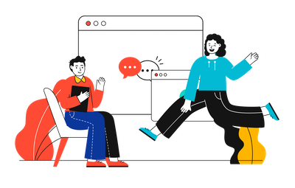



Prototype Design and Evaluation for SBI Website

Slide 2
Project analysis slide 6
Survey Review
Problems identified with SBI online website using Laws of UX
.
As Hicks Law states that the time it takes to make a decision increases with the number and complexity of choices. A simpler, more user friendly user interface is required.
Aesthetic-Usability Effect states that an aesthetically pleasing design creates a positive response in people’s brains and leads them to believe the design actually works better. An effective yet aesthetically pleasing design is needed for the website.
Many features such as login page, characters displayed on the screen and color scheme among others needs to re-evaluated and de-designed so as to increase the overall user experience.
As a user suggested a proper upfront navigation page is required.
A lot of the features provided by the bank are going unused and unvisited by the user. A better guide to available features is required.

Slide 3

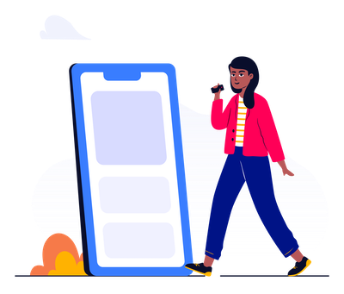
Prototype Design Using Figma

Slide 4

Prototype Design Using Figma

Slide 5
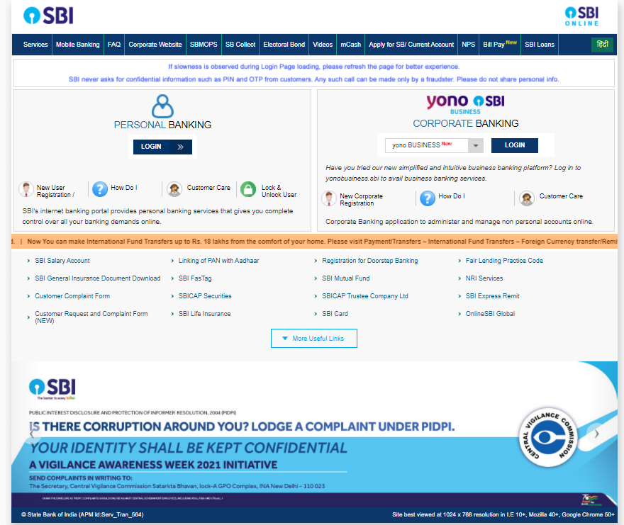
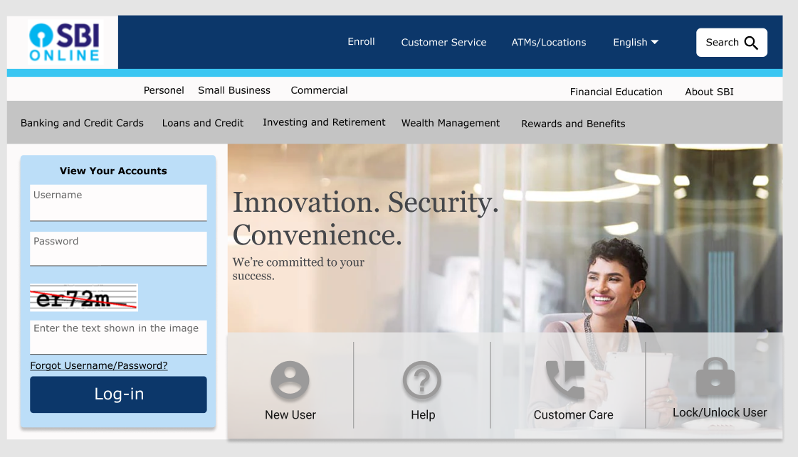
Website Welcome/Log in page

Slide 7
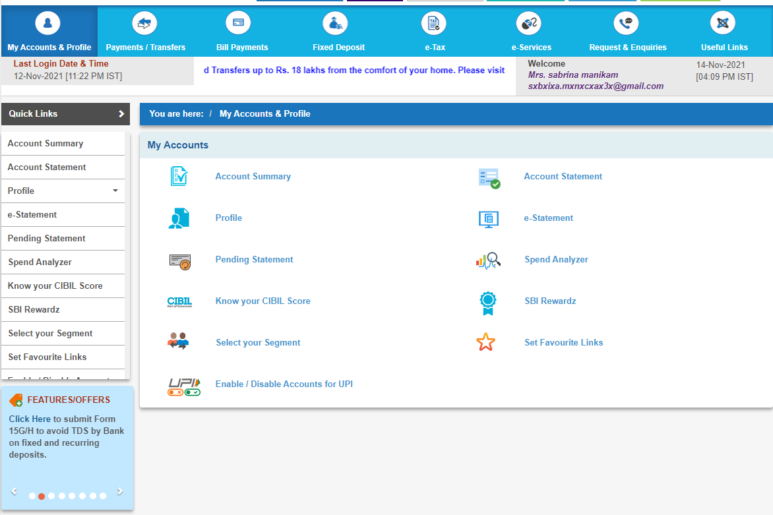
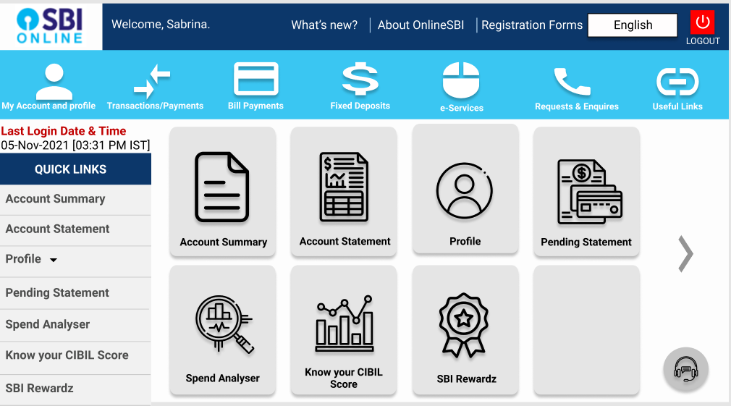

Slide 9
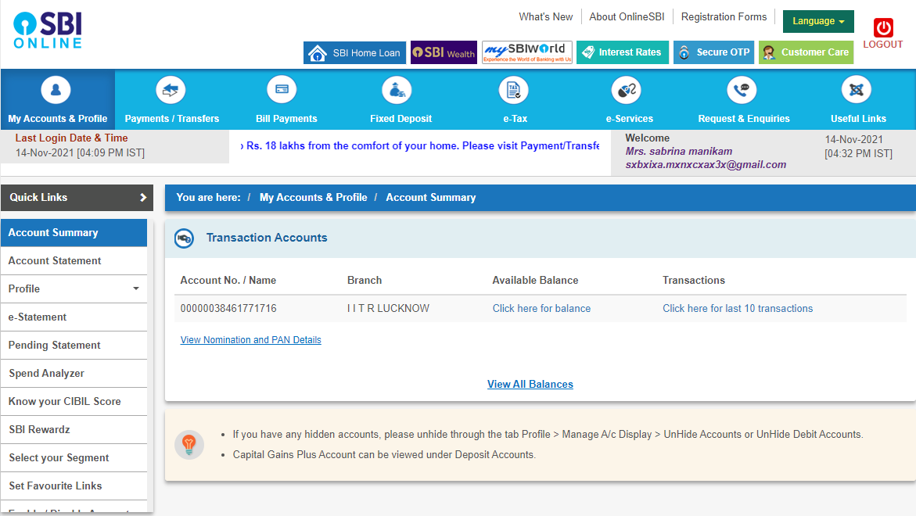
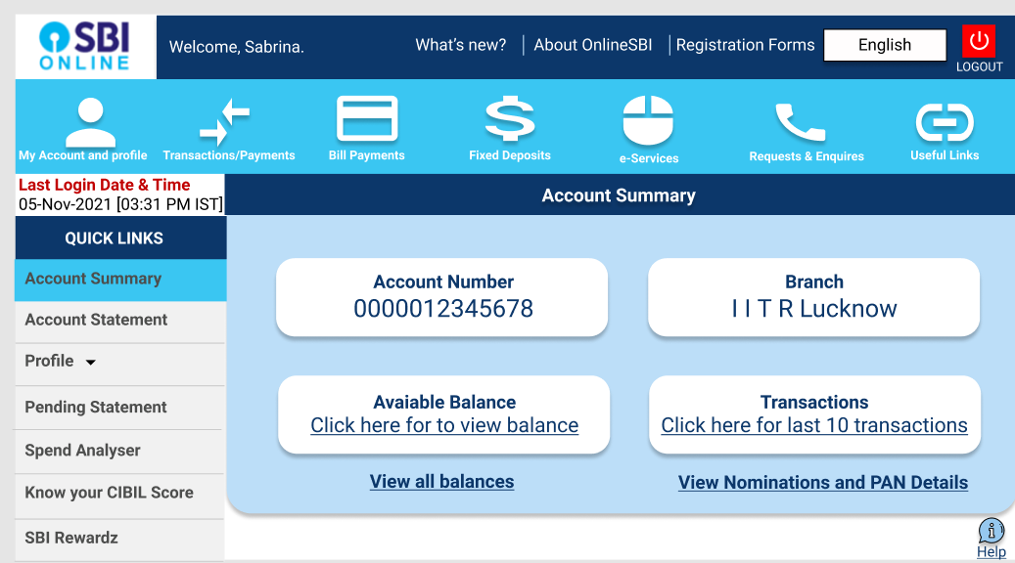

Slide 11
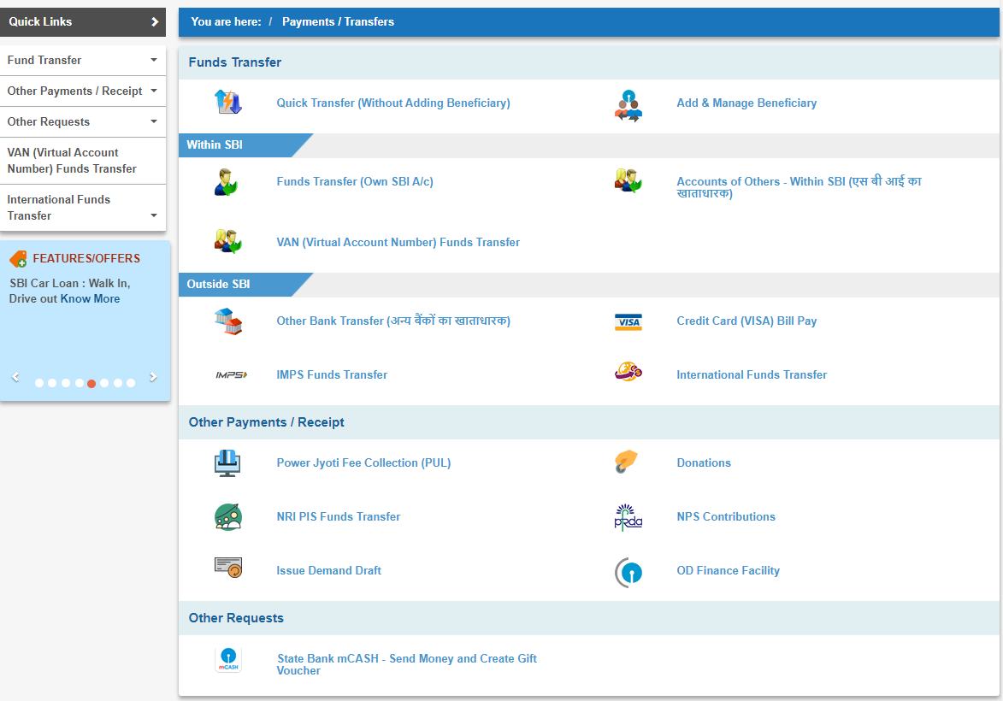
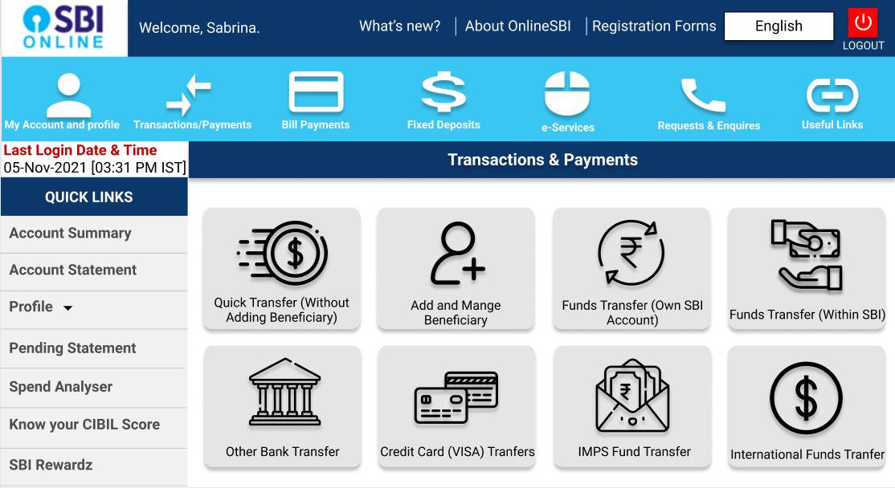

Slide 13
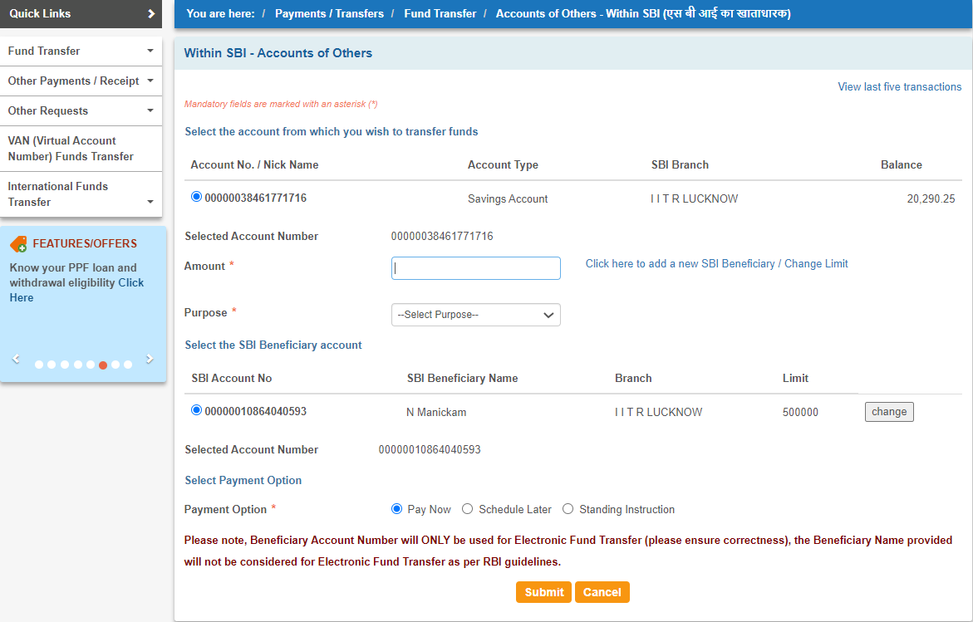
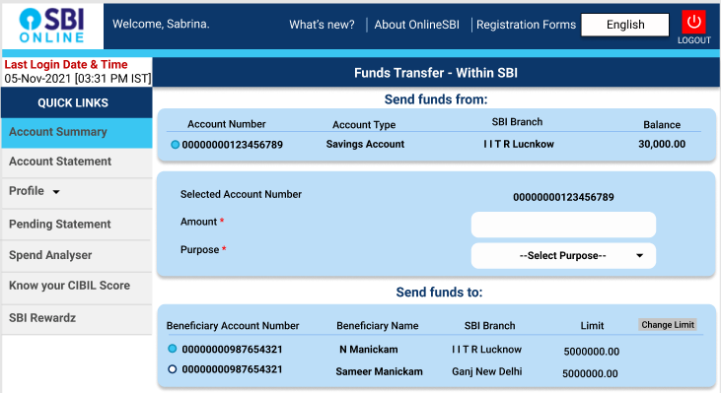

Slide 14
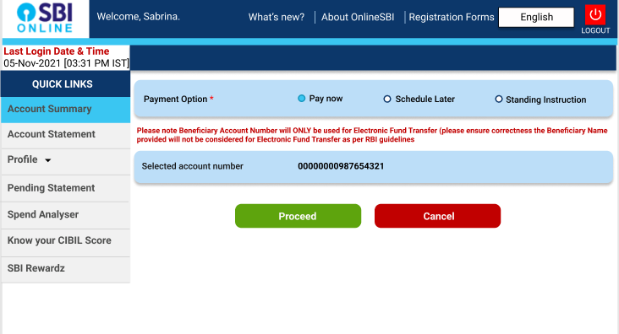

Slide 16


Evaluation

Slide 17
Evaluation

Slide 18

Aesthetic Usability Effect
Users often perceive aesthetically pleasing design as design that’s more usable.
An aesthetically pleasing design creates a positive response in people’s brains and leads them to believe the design actually works better.
People are more tolerant of minor usability issues when the design of a product or service is aesthetically pleasing.
Visually pleasing design can mask usability problems and prevent issues from being discovered during usability testing.
1
2
3

Slide 19
Aesthetic Usability Effect
Users often perceive aesthetically pleasing design as design that’s more usable.
An aesthetically pleasing design creates a positive response in people’s brains and leads them to believe the design actually works better.
People are more tolerant of minor usability issues when the design of a product or service is aesthetically pleasing.
Visually pleasing design can mask usability problems and prevent issues from being discovered during usability testing.
1
2
3

Slide 21

Law of Common Region
Elements tend to be perceived into groups if they are sharing an area with a clearly defined boundary.
Common region creates a clear structure and helps users quickly and effectively understand the relationship between elements and sections.
Adding a border around an element or group of elements is an easy way to create common region.
Common region can also be created by defining a background behind an element or group of elements.
1
2
3

Slide 22
Law of Common Region
Elements tend to be perceived into groups if they are sharing an area with a clearly defined boundary.
Common region creates a clear structure and helps users quickly and effectively understand the relationship between elements and sections.
Adding a border around an element or group of elements is an easy way to create common region.
Common region can also be created by defining a background behind an element or group of elements.
1
2
3

Slide 24

Law of Pragnanz
People will perceive and interpret ambiguous or complex images as the simplest form possible, because it is the interpretation that requires the least cognitive effort of us.
The human eye likes to find simplicity and order in complex shapes because it prevents us from becoming overwhelmed with information.
Research confirms that people are better able to visually process and remember simple figures than complex figures.
The human the eye simplifies complex shapes by transforming them into a single, unified shape.
1
2
3

Slide 25
Law of Pragnanz
People will perceive and interpret ambiguous or complex images as the simplest form possible, because it is the interpretation that requires the least cognitive effort of us.
The human eye likes to find simplicity and order in complex shapes because it prevents us from becoming overwhelmed with information.
Research confirms that people are better able to visually process and remember simple figures than complex figures.
The human the eye simplifies complex shapes by transforming them into a single, unified shape.
1
2
3

Slide 27

Fitt’s Law
The time to acquire a target is a function of the distance to and size of the target.
Touch targets should be large enough for users to accurately select them.
Touch targets should have ample spacing between them.
Touch targets should be placed in areas of an interface that allow them to be easily acquired.
1
2
3

Slide 28
Fitt’s Law
The time to acquire a target is a function of the distance to and size of the target.
Touch targets should be large enough for users to accurately select them.
Touch targets should have ample spacing between them.
Touch targets should be placed in areas of an interface that allow them to be easily acquired.
1
2
3

Slide 30

Hick’s Law
The time it takes to make a decision increases with the number and complexity of choices.
Minimize choices when response times are critical to increase decision time.
Break complex tasks into smaller steps in order to decrease cognitive load.
Avoid overwhelming users by highlighting recommended options.
1
2
3

Slide 31
Hick’s Law
The time it takes to make a decision increases with the number and complexity of choices.
Minimize choices when response times are critical to increase decision time.
Break complex tasks into smaller steps in order to decrease cognitive load.
Avoid overwhelming users by highlighting recommended options.
1
2
3

Slide 33


Cognitive Walkthrough

Slide 34

The Four Questions to be Asked during a Cognitive Walkthrough
1. Will the user try and achieve the right outcome?
2. Will the user notice that the correct action is available to them?
3. Will the user associate the correct action with the outcome they expect to achieve?
4. If the correct action is performed; will the user see that progress is being made towards their intended outcome?

Slide 35
1. Will the user try and achieve the right outcome?
This question is trying to examine whether the interface is making assumptions about a user’s level of experience or knowledge that aren’t accurate. It can also help identify when a user’s expectations of an action don’t align with the actual action taken because they are using other reference points and becoming confused.

Slide 36
2. Will the user notice that the correct action is available to them?
Hidden or obscured controls are a problem for users. The more data that you present and the more choice that you present; the less likely it is that a user will know what to do. If you bury a control in a menu system rather than having it present while an action is taking place, the same is true; your users won’t know what to do.

Slide 37
3. Will the user associate the correct action with the outcome they expect to achieve?
If your use of language is poor, for example you use overly complex words or industry jargon, it can be hard for a user to work out what is needed to achieve their outcome. Steve Krug, says in his book “Don’t Make me Think” – “It doesn’t matter how many times I have to click, as long as each click is a mindless, unambiguous choice.”

Slide 38
4. If the correct action is performed; will the user see that progress is being made towards their intended outcome?
This will help you investigate when feedback in the system is missing, badly worded, easy to miss or plain old ambiguous. You need to let your users know about the progress they are making in the task.

Slide 39






Slide 41
REFERENCES
https://lawsofux.com/
https://www.interaction-design.org/literature/article/how-to-conduct-a-cognitive-walkthrough
https://figmaelements.com/
https://blush.design/
https://www.wellsfargo.com/

Slide 42

Thank you!

